Slide 1


Report Analytics & Dashboard Analytics for Stake-Holders
01
Opportunity
Group – 2
Vaishali Timase
Pravin Patil
Chaitali Sure
Shreyash Patil
Rajat Upadhyay
Harshwardhan Murkute
Akash Gupta
06
02
05
Lead
04
03

Slide 2
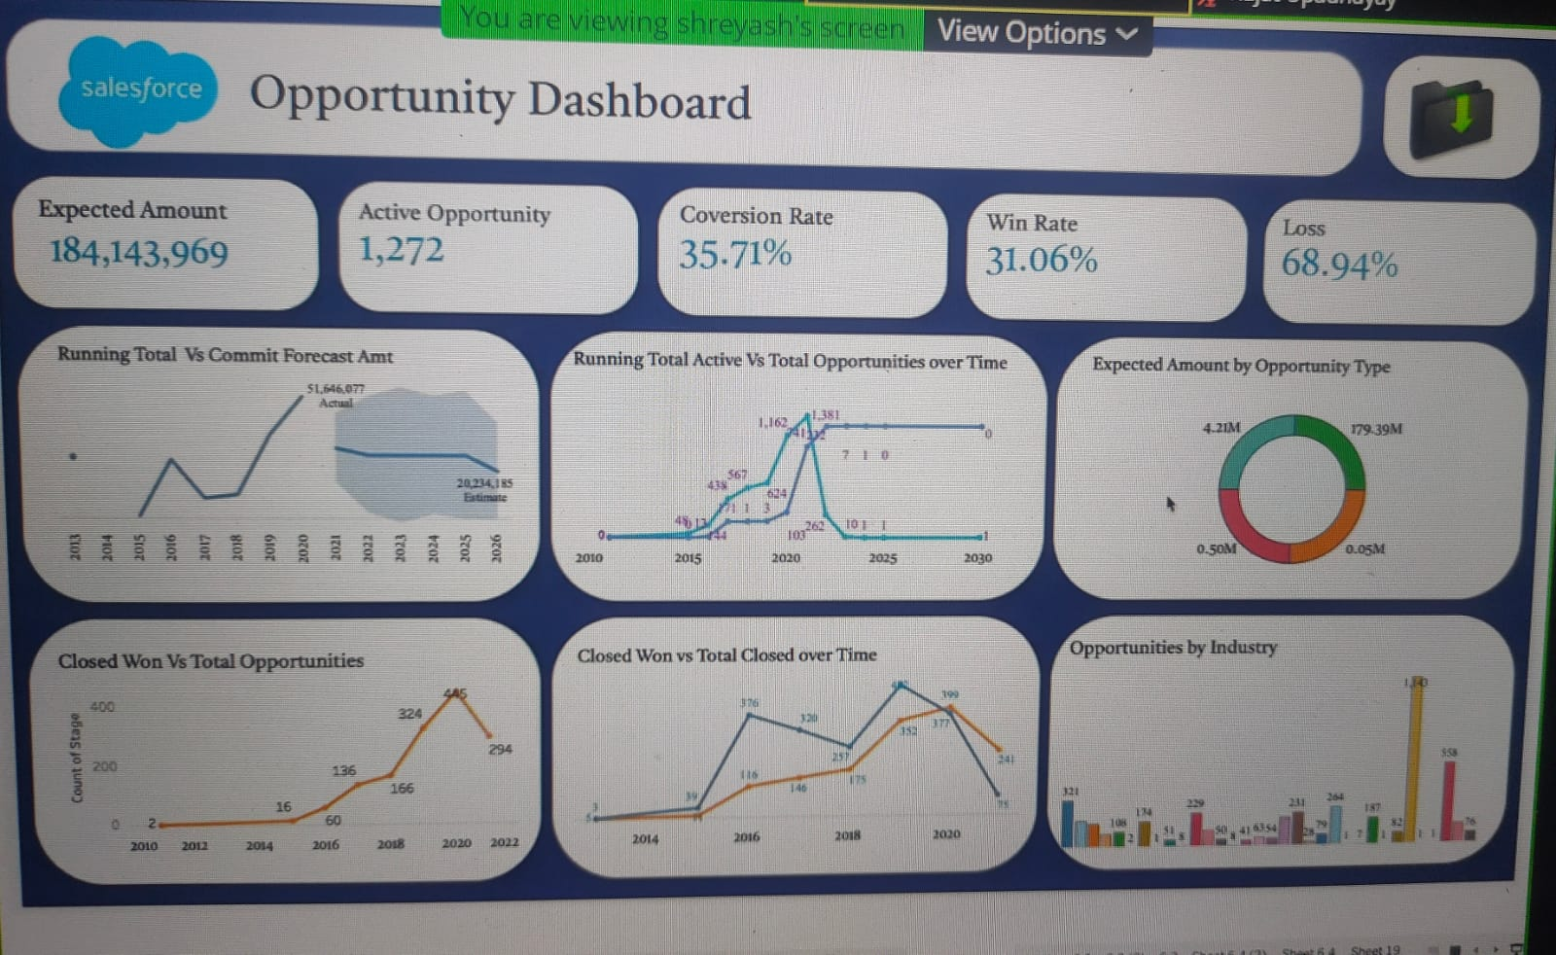
Opportunity Dashboard
Expected Amount
Active Opportunities
Conversion Rate
Win Rate
Loss
Trend Analysis
Running Total Expected Vs Commit Forecast Amount over Time
Running Total Active Vs Total Opportunities over Time
Closed Won Vs Total Opportunities over Time
Closed Won vs Total Closed over Time
Expected Amount by Opportunity Type
Opportunities by Industry

Slide 3
Opportunity Dashboard
Opportunities are past or pending sales for an account that
You want to work or track.
Here we calculated an expected amount is 184.14M.
Win rate is 31% and loss rate is 68% as seen in above ppt.
If a specific record in the opportunity you are willing to clone has a field you do not have access to, the field in the cloned record will be blank. Here we seen in Expected amount vs Opportunity type chart blank records have Maximum count.
In this, in opportunity vs Industry chart Biopharma and State and local industries have highest count of opportunities than any other industries.

Slide 4
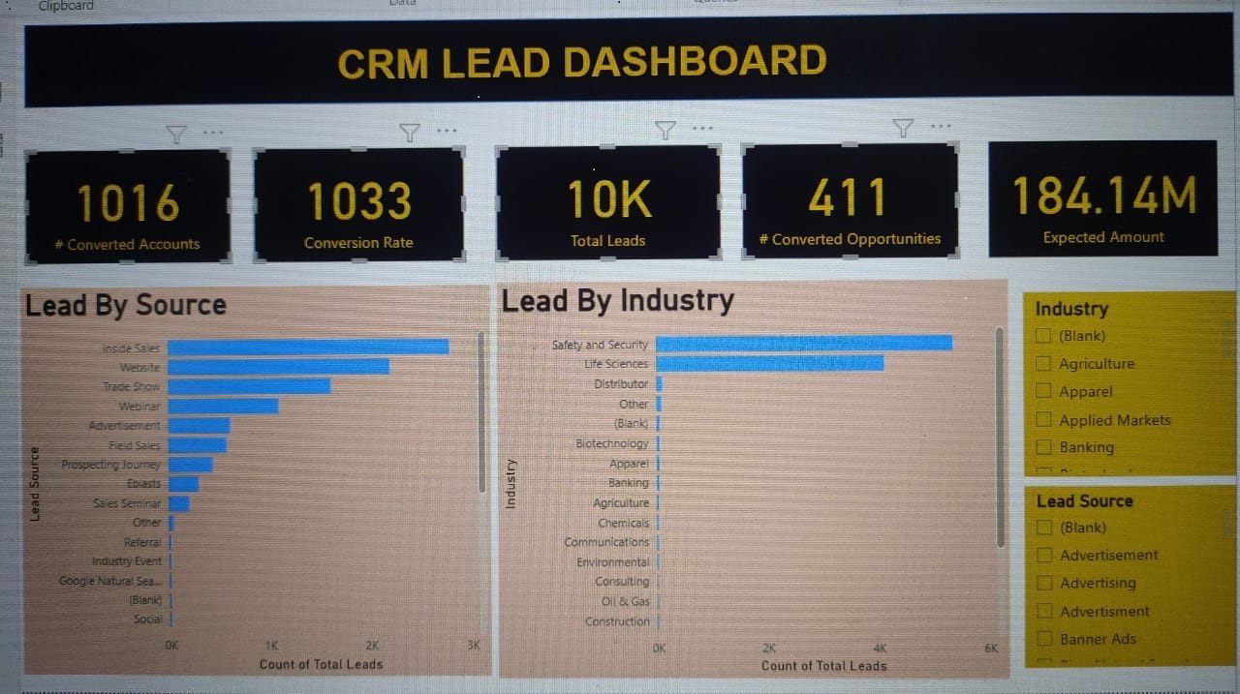
Lead Dashboard
Total Lead
Expected Amount from Converted Leads
Conversion Rate
Converted Accounts
Converted Opportunities
Lead By Source
Lead By industry

Slide 5
Lead Dashboard
In lead by source chart , Inside sales and website are the sorces
which generated the most revenue.
In Lead by Industry chart, Safety and Security , and life science field
Having highest total leads.
Here we get converted accounts are 1016 count, Total leads are 10K,
Converted opportunities are 411 and expected amount is 184.14M.
This lead dashboard will enable us to make on the fly decisions and adjust
marketing activities based on real time data and how to choose future goals.

Slide 6
Thank You

